Slide 1
Agentic testing category video awareness campaign.
Marketing pack – May 2025
The UiPath word mark, logos, and robots are registered trademarks owned by UiPath, Inc. and its affiliates. UiPath (R) is a registered trademark in the United States and several countries across the globe. See TMEP 906. ©2025 UiPath. All rights reserved.

Slide 2
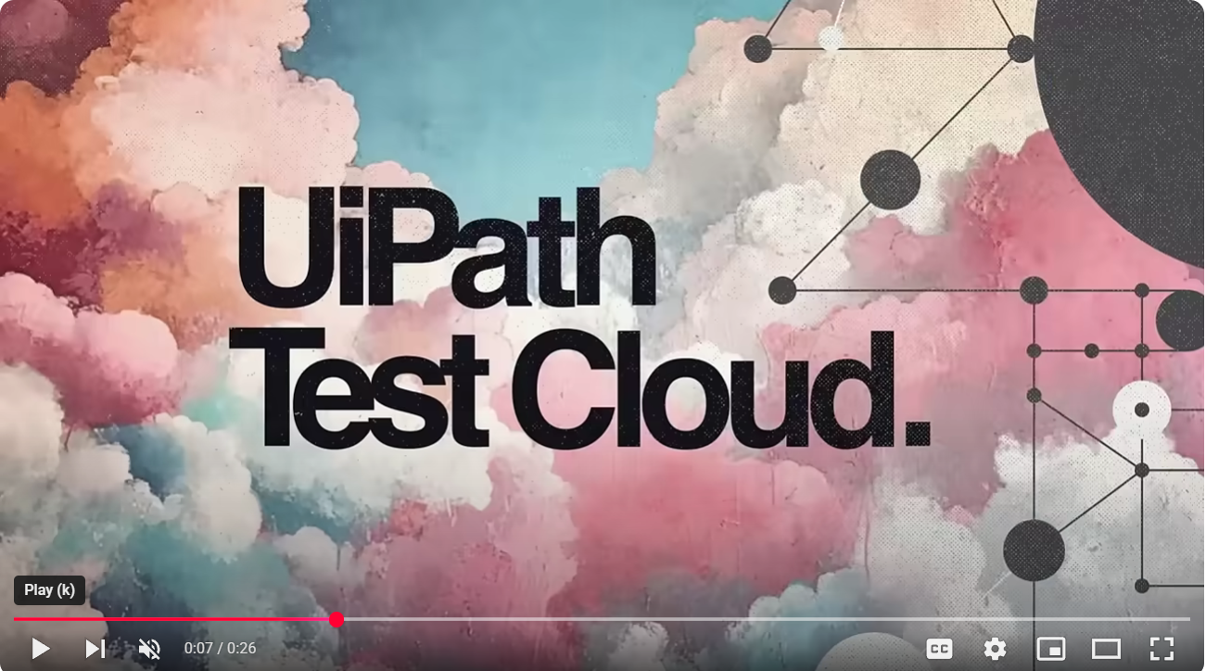





Paid media – LinkedIn video in platform campaign. .
Why – To raise awareness of Agentic testing category led by UiPath Test Cloud.
What - To add the narrative around the five video phrases & embed these in our customers heads and then associate these phrases with the Agentic testing vision and Test Cloud capabilities.
How -
Original post, vision to come from Gerd or other internal influencer for Agentic testing.
others to repost with comments from product truth perspective
UiPath HQ public post for all company.
Video short made public on Youtube
Length : 5+ weeks
We have developed five :25 sec video awareness spots that each have a specific phase / saying meant to embed with repetition. We will explain through social posts and articles. These spots will be run as paid media ads driving to https://www.uipath.com/platform/agentic-testing
Tools for the new rules – https://www.youtube.com/watch?v=k8zYVPL0zd8
Get more done, do less dumb, have more fun. - https://www.youtube.com/watch?v=4Y8AjmKOXho
Wring the bottleneck. - https://www.youtube.com/watch?v=NKTWpSjQspU
Tools that let you lead, not bleed. - https://www.youtube.com/watch?v=1YCb5HlRSO4
No more Frankensteining, no more whining. - https://www.youtube.com/watch?v=uP8DsdQRtVg
Tools for the new rules – Public full 1min spot
https://www.youtube.com/watch?v=MdNiBr2e4ww
ACTIONS:
1) Use this 1 min video share with others in social and with partners.
2) Repost from UiPath HQ

Slide 3



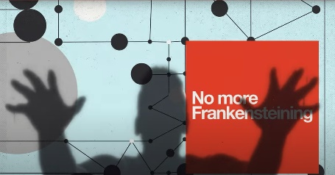

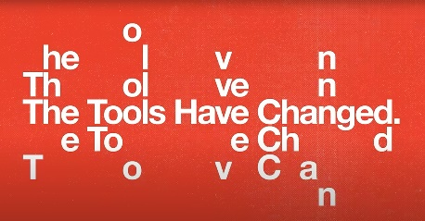
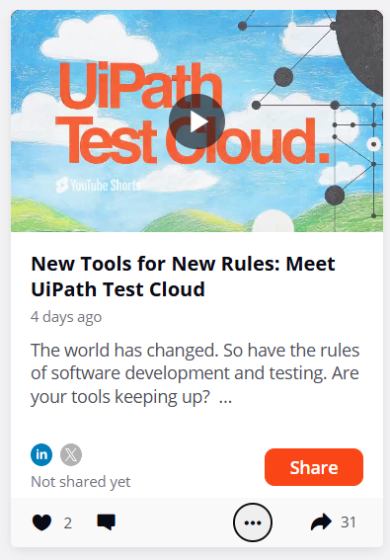
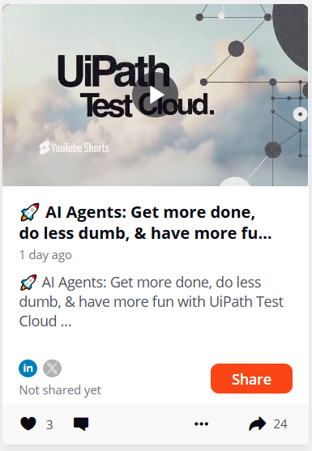
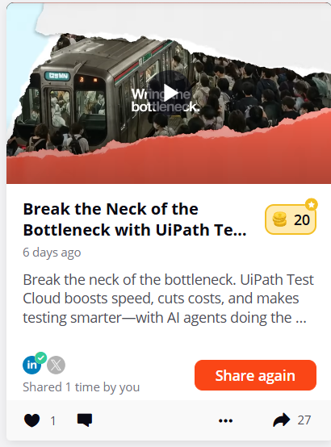
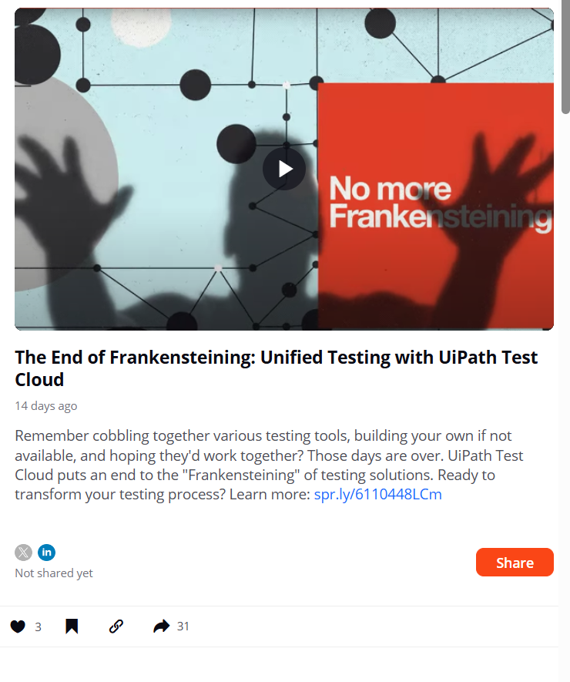
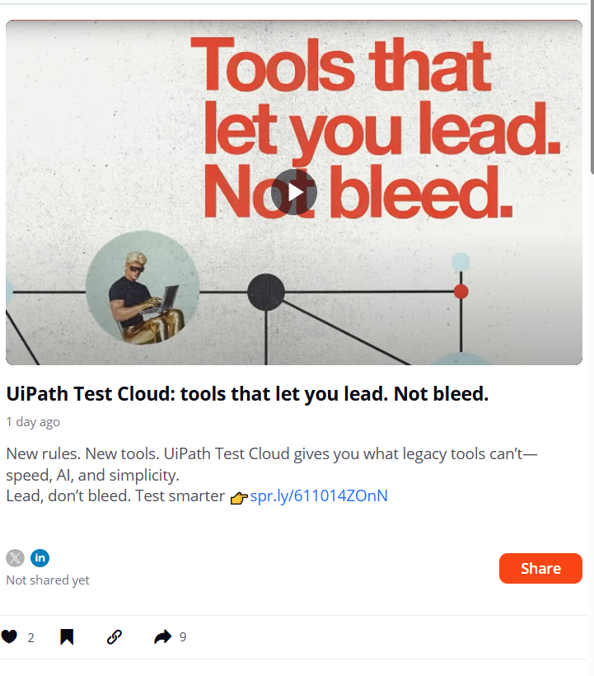
Social amplification materials
Social graphics, short & long copy along with LinkedIn and Zoom backgrounds.
May 13 th
May 22 th
May 29 th
June 9 th
June 23 rd
The rules have changed. Now the tools have changed with UiPath Test Cloud.
Discover the most comprehensive, up-to-date, and AI-enabled agentic testing tools redefining software quality assurance. Be a software hero: New tools for the new rules.
Get more done, do less dumb, & have more fun with UiPath Test Cloud.
Experience the power of AI agents that are revolutionizing software quality assurance. Be a software hero: get more done, do less dumb, and have more fun.
Break the neck of the bottleneck with UiPath Test Cloud.
Tired of QA testing holdups? Accelerate testing & boost quality with AI enabled agentic testing tools. Be a software hero: Wring the neck of the bottleneck.
No more Frankensteining, no more whining with UiPath Test Cloud
Stop cobbling together old tech & hoping it works? Out with the old and in with a bold unified, powerful testing platform. Be a software hero: no more Frankensteining.
Stop bleeding and start leading with UiPath Test Cloud
Leave outdated tools behind. Equip yourself with AI enabled cutting-edge solutions for today's testing challenges. Be a software hero: lead, don't bleed.
https://uipathhq.sprinklr.com/content/ADVOCACY_205_682b81d6f104e30f3cc1d1ab?sourceType=ACCOUNT
https://uipathhq.sprinklr.com/content/ADVOCACY_205_6838748eac0e314953e16a7e?sourceType=ACCOUNT
https://uipathhq.sprinklr.com/content/ADVOCACY_205_68418df8e1b5e63c6a48ed33?sourceType=ACCOUNT
https://uipathhq.sprinklr.com/content/ADVOCACY_205_6857d2a04f770f7a83daf8b8?sourceType=ACCOUNT
https://uipathhq.sprinklr.com/content/ADVOCACY_205_681d857f864620715419450b?sourceType=ACCOUNT
Social copy in progress:
https://uipath.sharepoint.com/:w:/r/sites/ProductMarketing/_layouts/15/Doc.aspx?sourcedoc=%7B92E9A6CF-2DBE-46C4-A1AB-FB9B3CEAD470%7D&file=Awareness%20video%20posts.docx&action=default&mobileredirect=true
LinkedIN and Zoom backgrounds
TestCloud_LinkedIN headers
TestCloud_Zoom backgrounds

Slide 4

Tools for the new rules
The rules have changed. Now the tools have changed with UiPath Test Cloud.
Social graphic
emails
one pager
Social copy
In progress
🌟 New Tools for New Rules: Meet UiPath Test Cloud 🌟
The world has changed. So have the rules of software development and testing. Are your tools keeping up?
🚀 UiPath Test Cloud: A revolution in software quality assurance.
Why it's a game-changer:
• AI-enabled agentic testing tools
• Most comprehensive and up-to-date platform
• Redefines system and software quality assurance
Be a software superhero: Equip your team to master the new rules with UiPath Test Cloud. Ready to revolutionize your testing process?
Learn more: www.uipath.com/agentictesting
#UiPathTestCloud #SoftwareTesting #QualityAssurance #AITesting
What's your biggest challenge in software testing? Let's discuss!
ebook
In progress

Slide 5

Get more done, do less dumb, have more fun.
Get more done, do less dumb, & have more fun with UiPath Test Cloud.
Social graphic
emails
Social copy
🚀 AI Agents: Get more done, do less dumb, & have more fun with UiPath Test Cloud
At UiPath, we're not just changing the game – we're rewriting the rules of software testing. Introducing UiPath Test Cloud with AI agents: the innovation that's transforming quality assurance.
Our mission? Simple:
✅ Get More Done: AI agents tackle more projects and scenarios than ever before
✅ Do Less Dumb: Eliminate repetitive tasks and human errors
✅ Have More Fun: Free your team to focus on creative, high-value work
With UiPath Test Cloud, you're not just keeping up with change – you're driving it. Experience the most comprehensive, up-to-date, and intelligent testing platform in the market today.
Ready to transform your testing process? Learn more: www.uipath.com/agentictesting
#UiPathTestCloud #AITesting #SoftwareQA #GetMoreDoneDoLessDumbHaveMoreFun
How could AI-powered testing help your team get more done, do less dumb, and have more fun? Share your thoughts!

Slide 6

Wring the bottleneck
Break the neck of the bottleneck with UiPath Test Cloud.
Social graphic
emails
Social copy
🚀 Break the Neck of the Bottleneck with UiPath Test Cloud
In today's fast-paced digital landscape, QA testing holdups can significantly slow down software delivery. But those days are over. UiPath Test Cloud is here to revolutionize your testing process.
Our AI-enabled agentic testing tools don't just accelerate testing – they transform it:
• Superhuman speed and accuracy • Boosted quality assurance • Reduced costs and resource intensity
🎯 Key Benefits:
✅ Get more done
✅ Do less dumb work
✅ Have more fun
UiPath Test Cloud represents a significant shift towards AI-augmented testing, focusing on collaboration between people and AI agents to enhance the complete testing process.
Be a software hero: Break the neck of the bottleneck. It's time to lead the charge in testing efficiency with UiPath Test Cloud.
Ready to revolutionize your testing process? Learn more: www.uipath.com/agentictesting
#UiPathTestCloud #AITesting #SoftwareQA #TestingEfficiency
How could AI-powered testing help your team get more done, do less dumb work, and have more fun? Share your thoughts!

Slide 7
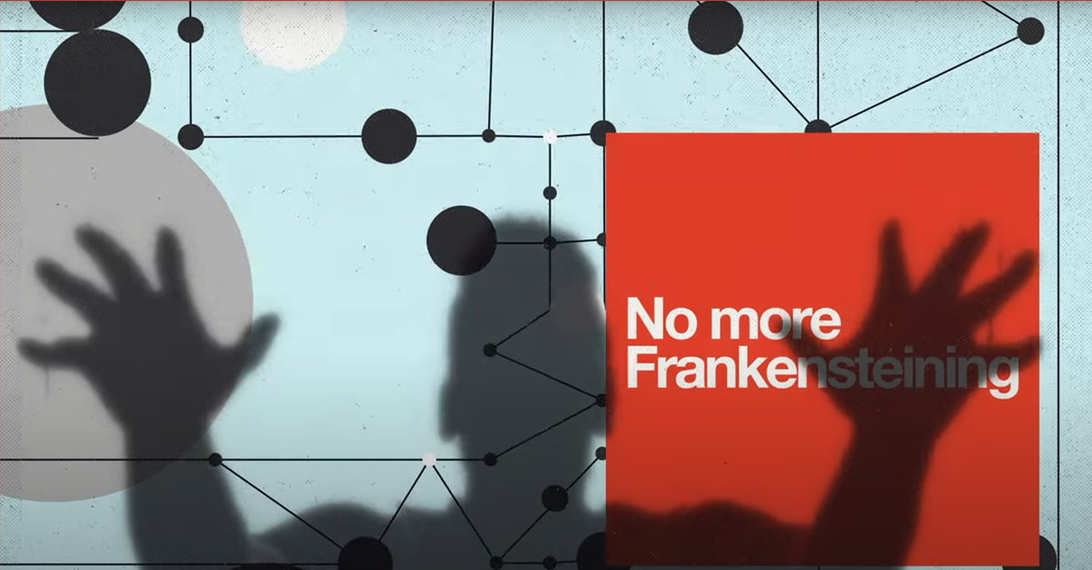
No more Frankensteining
No more Frankensteining, no more whining with UiPath Test Cloud.
Social graphic
emails
Social copy
🚀 The End of Frankensteining: Unified Testing with UiPath Test Cloud
Remember cobbling together various testing tools, building your own if not available, and hoping they'd work together? Those days are over. UiPath Test Cloud puts an end to the "Frankensteining" of testing solutions.
🔧 What UiPath Test Cloud offers:
• A unified, powerful testing environment
• Elimination of multiple disjointed tools
• A seamless, efficient testing process that drives quality and speed
It's not just about convenience – it's about revolutionizing how we approach software testing.
👋 Say goodbye to the monster of mismatched tools.
🎉 Embrace the future of unified testing with UiPath Test Cloud.
Ready to transform your testing process? Learn more: www.uipath.com/agentictesting
#UiPathTestCloud #UnifiedTesting #QualityAssurance #NoMoreFrankensteining
What's your biggest challenge with integrating multiple testing tools? Let's discuss!

Slide 8
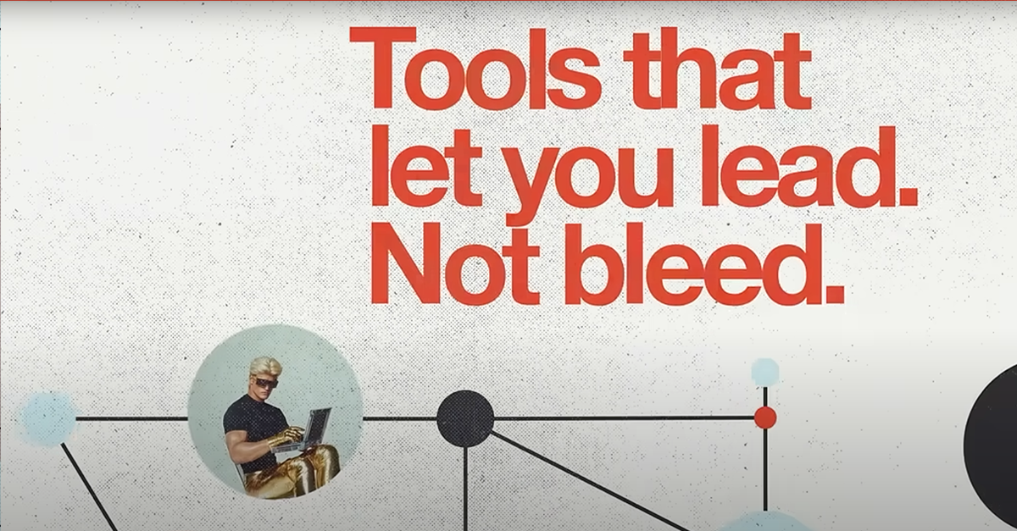
No more Frankensteining
No more Frankensteining, no more whining with UiPath Test Cloud.
Social graphic
emails
Social copy
🚀 The End of Frankensteining: Unified Testing with UiPath Test Cloud
Remember cobbling together various testing tools, building your own if not available, and hoping they'd work together? Those days are over. UiPath Test Cloud puts an end to the "Frankensteining" of testing solutions.
🔧 What UiPath Test Cloud offers:
• A unified, powerful testing environment
• Elimination of multiple disjointed tools
• A seamless, efficient testing process that drives quality and speed
It's not just about convenience – it's about revolutionizing how we approach software testing.
👋 Say goodbye to the monster of mismatched tools.
🎉 Embrace the future of unified testing with UiPath Test Cloud.
Ready to transform your testing process? Learn more: www.uipath.com/agentictesting
#UiPathTestCloud #UnifiedTesting #QualityAssurance #NoMoreFrankensteining
What's your biggest challenge with integrating multiple testing tools? Let's discuss!

Slide 9
Meet UiPath Test Cloud for our partners
The most open, secure set of agentic testing software tools ever assembled under one cloud
Why: Increase $$ for your testing practice.
Emails
Newsletter inserts
Social posts
Copy for newsletters or emails
Welcome to the new era of testing.

